Slide 1
Материалы термического интерфейса; Полные решения
ООО Фошань Лианьсинь Полупроводниковые Материалы

Slide 2
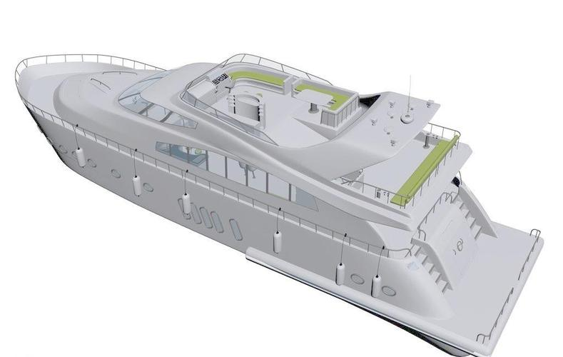
Yacht Thermal Conductive Part
Cockpit:
Power Supply Module
Communication Equipment
Flight Control System
Common Area:
Energy Storage Converter
Energy Storage Capacitor
LED Light
Sensor
Power Compartment:
Electric Motor
Energy Storage Battery
Engine

Slide 3
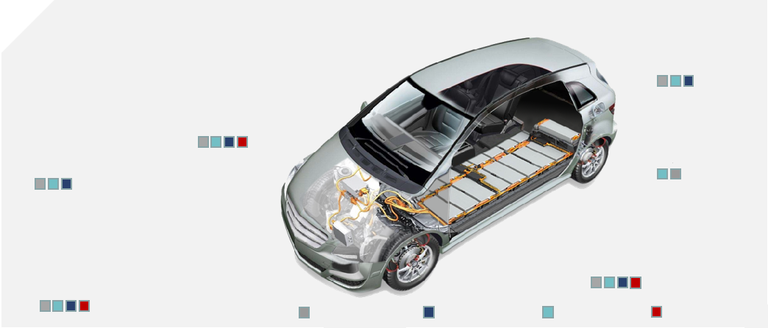
Thermal Conductive Part
Entertainment and communication system
Telephone and antenna
Smart rearview mirror
Acoustic Visual System
Smart display
Printed Circuit Board、chip
Global Positioning System (GPS and Beidou)
Navigation and on-board intelligent communication system
Information Collection
Battery Management
Driving Safety System
Power Battery Pack
Car Reversing Aid Device
Collision warning system
Supplemental Inflatable Restraint System
Activity safety belt
Braking system
Adaptive Cruise Control (ACC)
Automotive Assisted Driving System (ADAS)
Charging System
Vehicle-mounted charger
Charging handle
Charging station
Body and chassis system
Engine management and transmi s sion agency
Electric vehicle lighting system
Air conditioning system
Wiper system
Information collection
Doors, windows, rear-view mirror control system
Instrument Cluster Computer
Automobile starting unit
Speed control unit
Power transmission system
Electric Power Steering
Adhesive and encapsulant products
Using EMI shielding products
Using thermal management products
Using optical display products

Slide 4
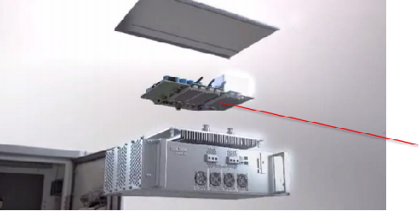
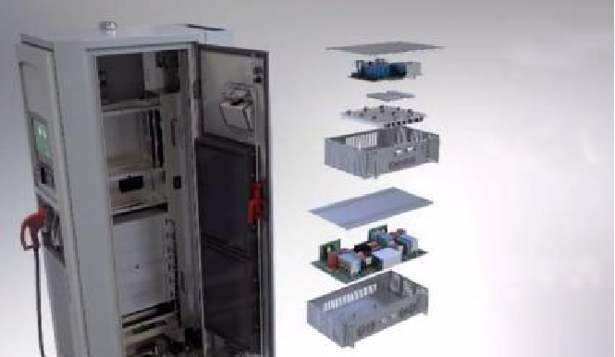
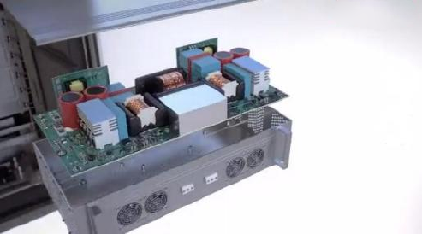
Thermal Conductive Applications for Servers
Functional module system
Thermal Interface Materials
• Thermal Pads
• Thermal Gel
Different types of
conversion board
Functional module system
Discrete component system
Discrete component system
Thermal Potting Compound
Thermal Pad
Thermal Conductive Structural Adhesive

Slide 5

Thermal Conductive Applications for Drones
1
Thermal pad or silicone grease
Thermal pad or silicone grease
Thermal pad or silicone grease
Singlecomponent potting adhesive (low viscosity)

Slide 6
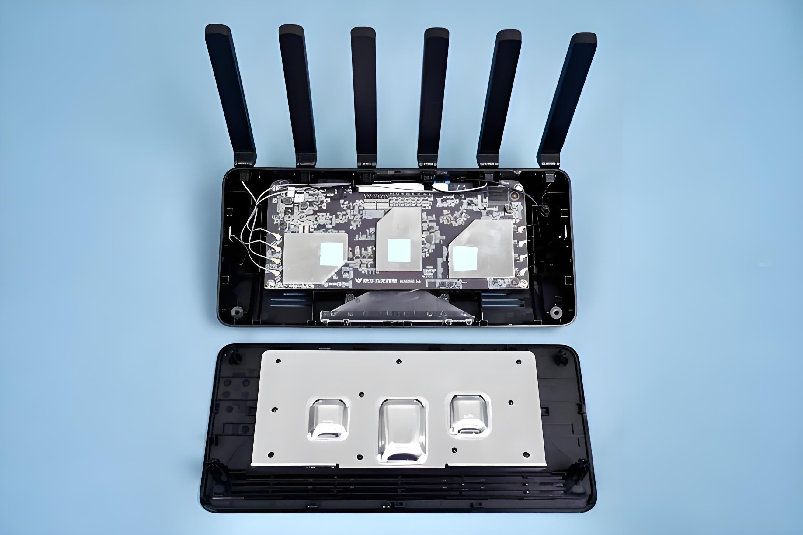
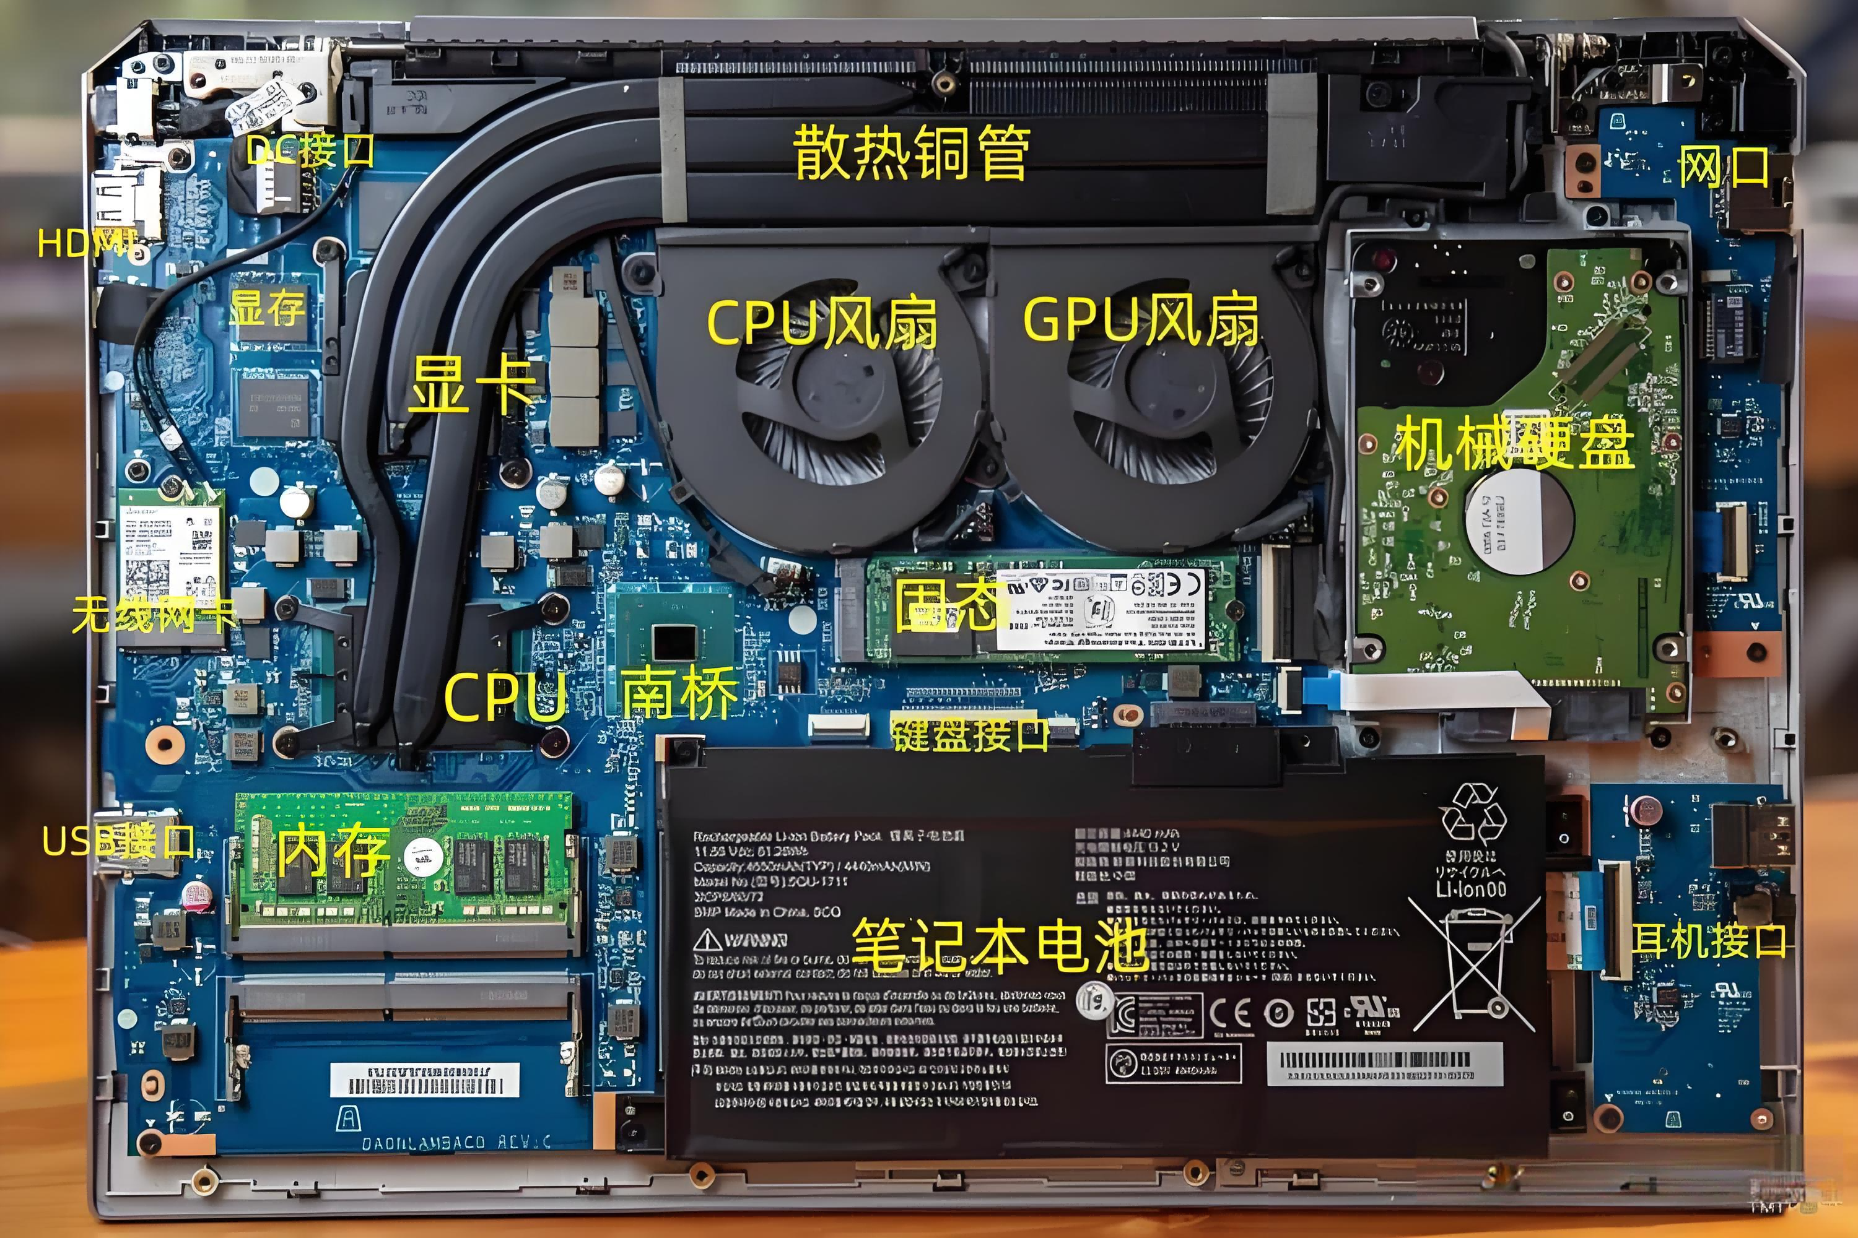
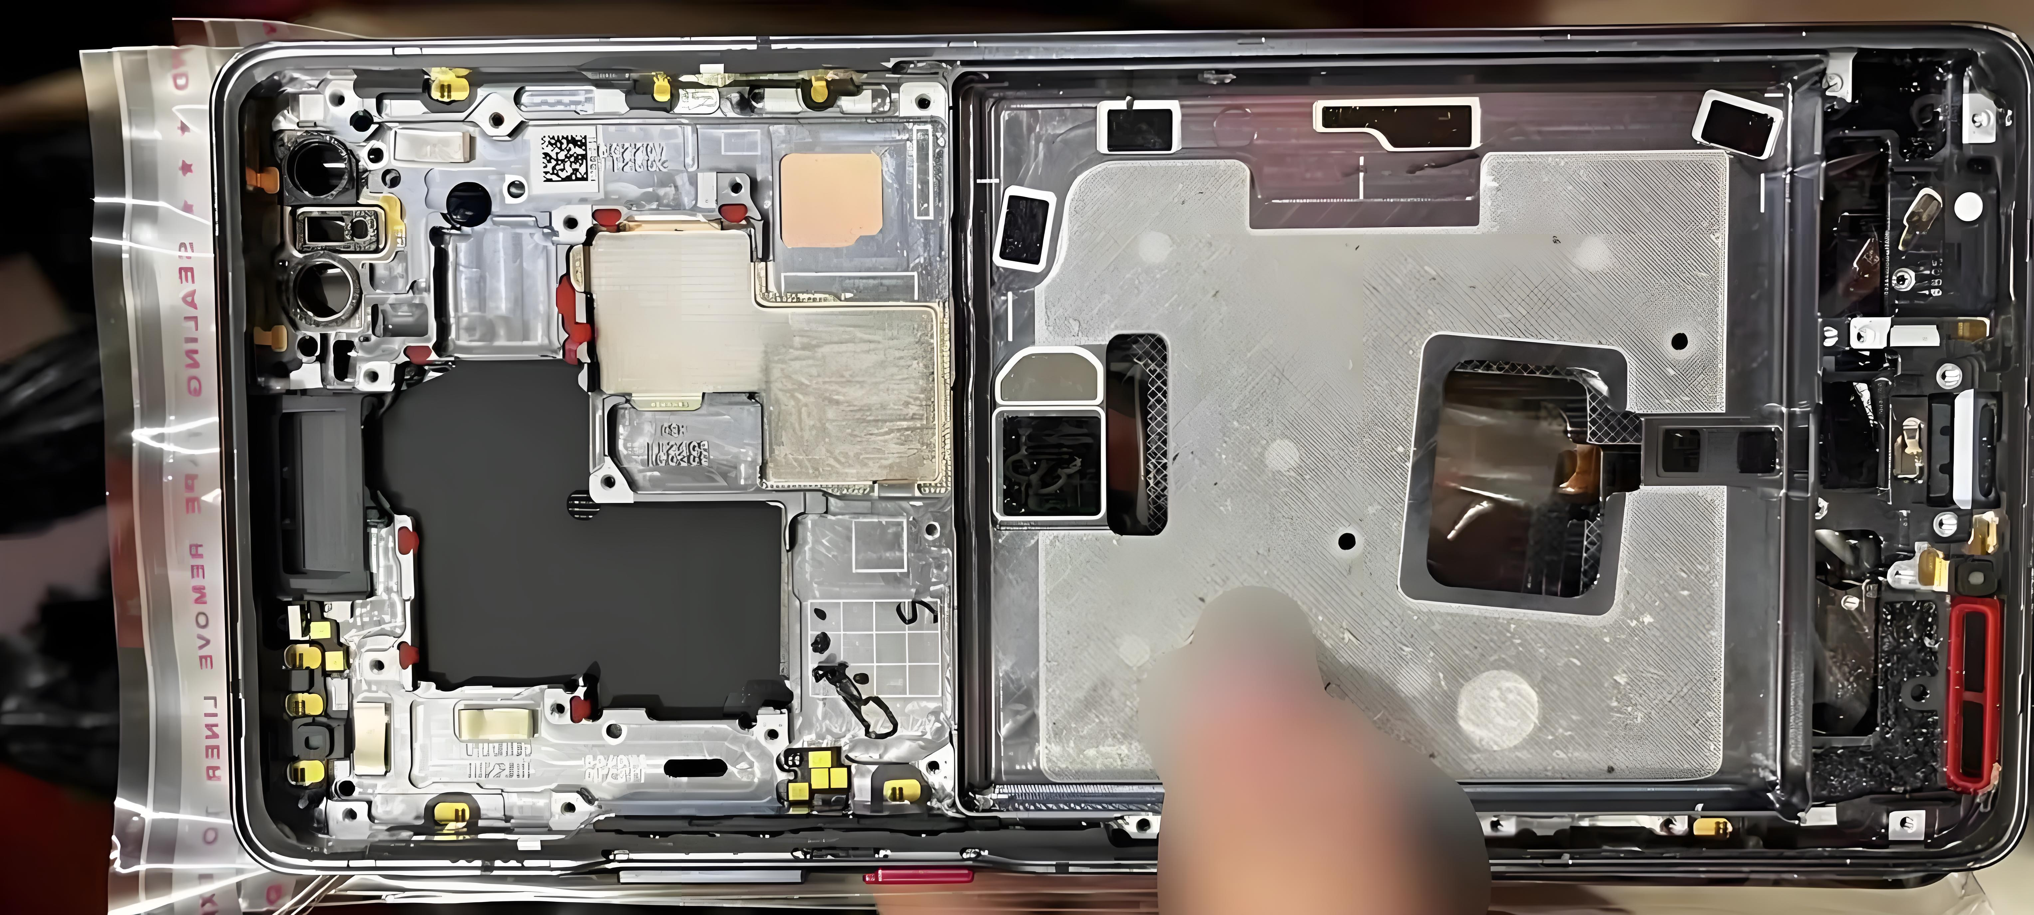
Thermal Conductive Applications for 3C Products
Router
- Thermal Grease
- Thermal Pad
- Thermal Gel
thermal gel
thermal pad
PC
PHONE

Slide 7
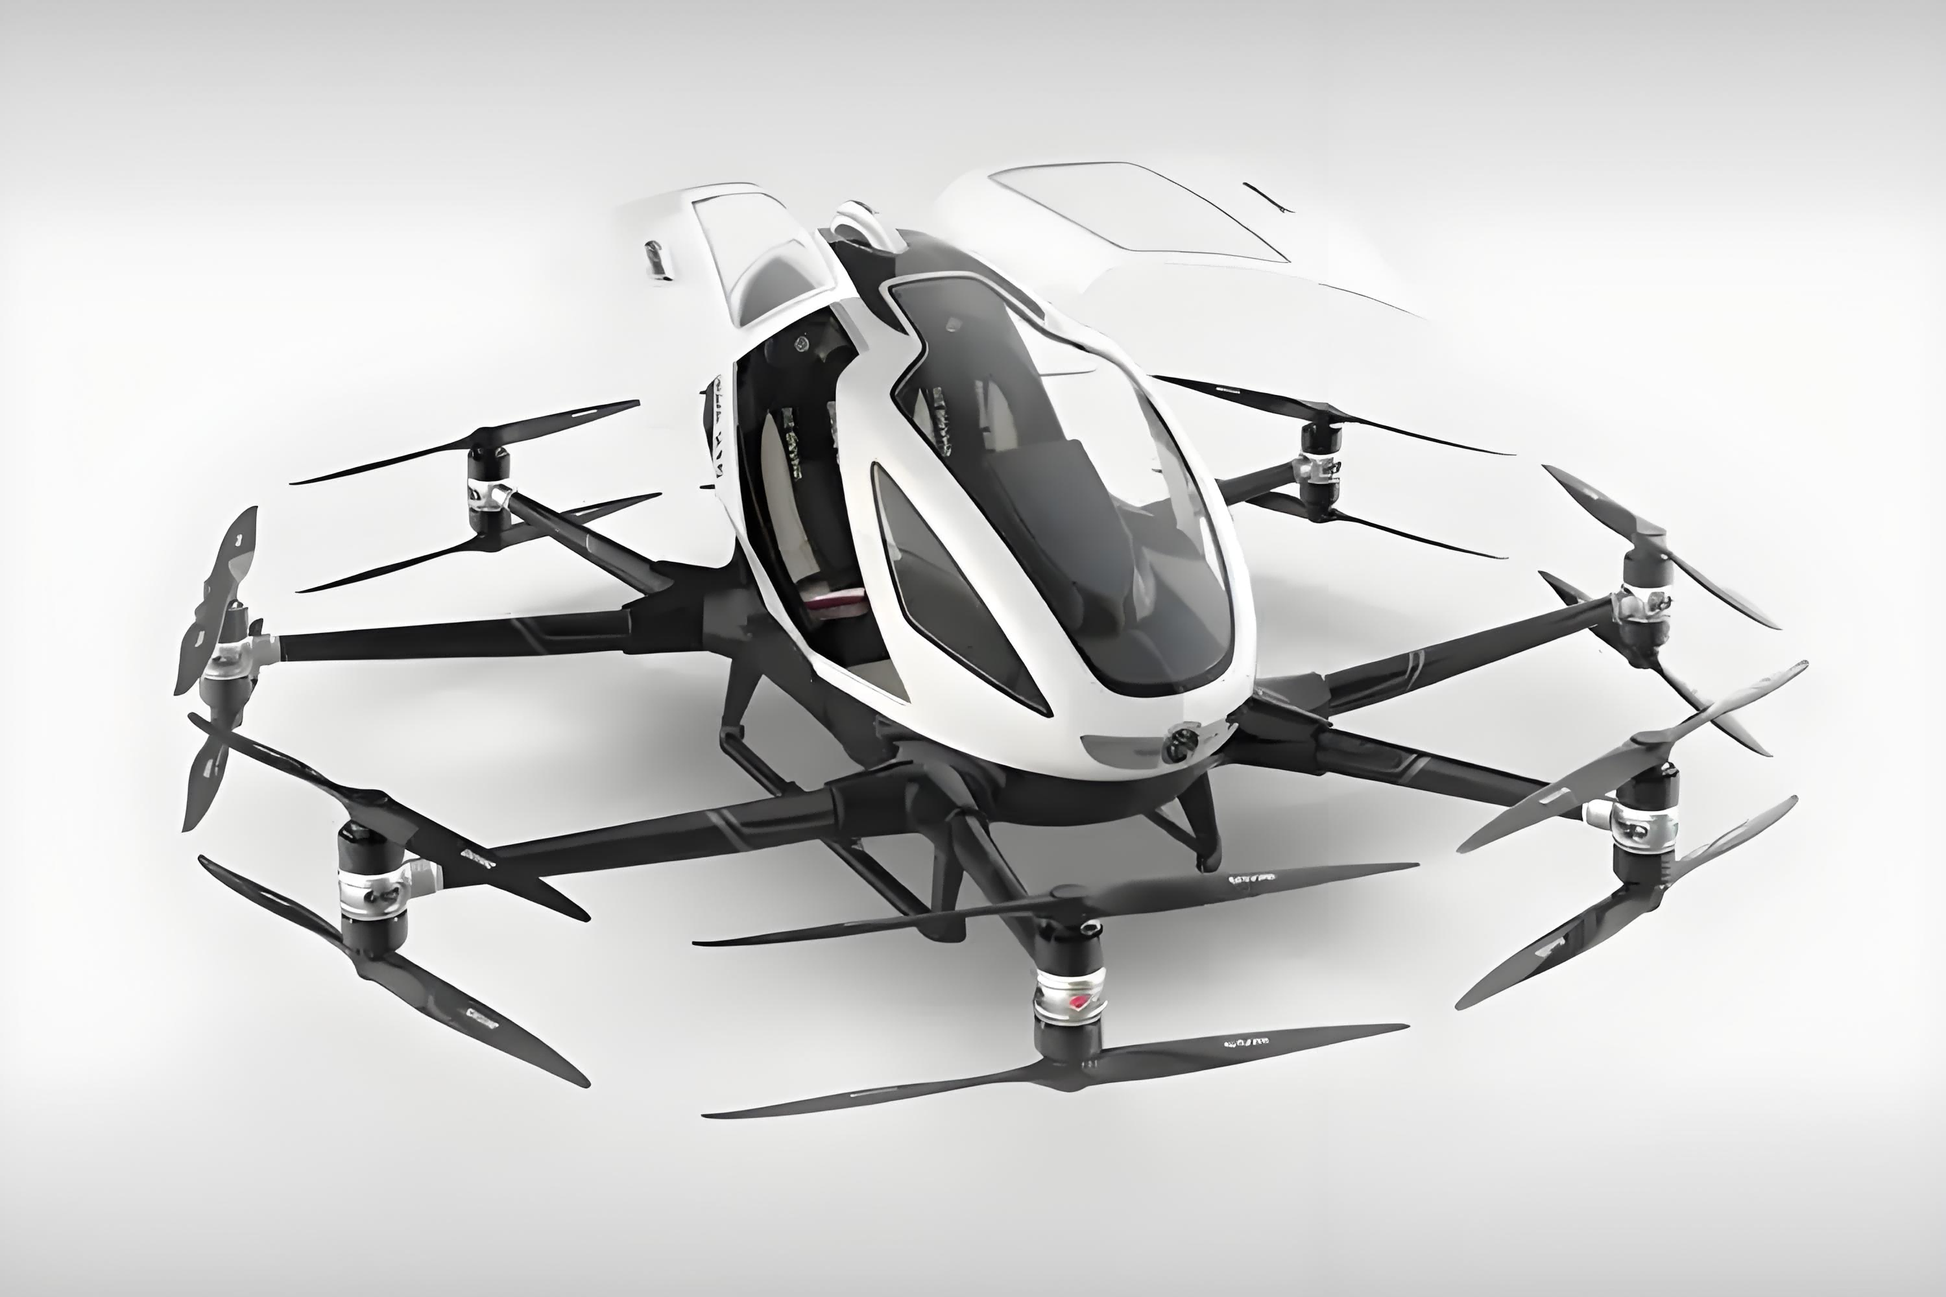
low-altitude flight
Thermal Potting Compound
Thermal Gel
Thermal Pad
Thermal Gel
Thermal Pad
Thermal Paste
.

Slide 8
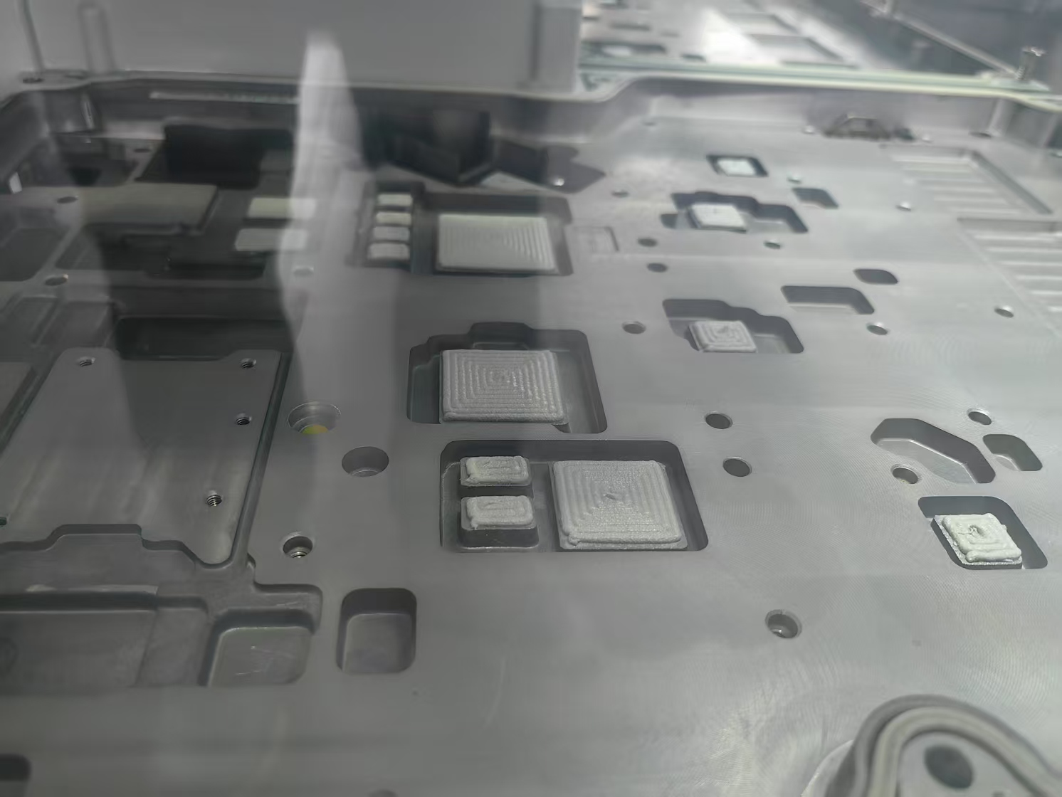
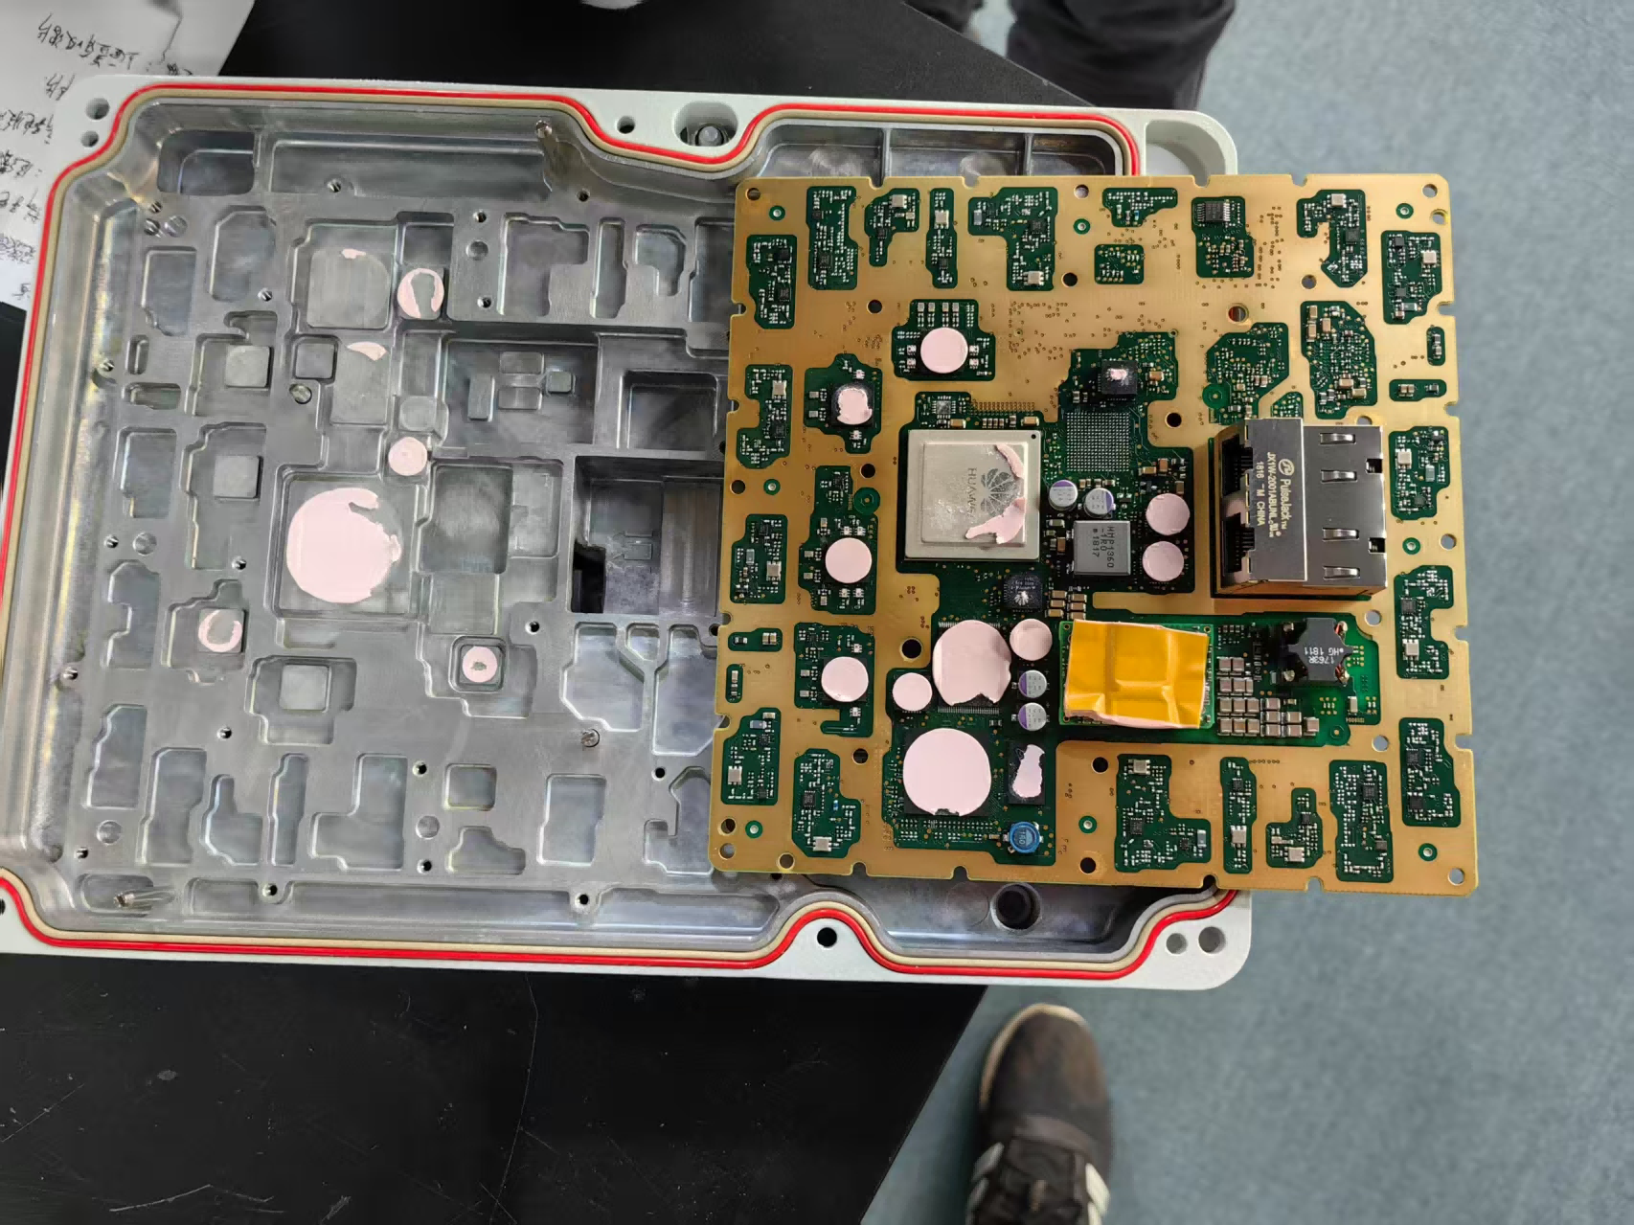
The application of 5G communication base stations
Front
Back
One-component gel
One-component gel, thermal pad
.

Slide 9
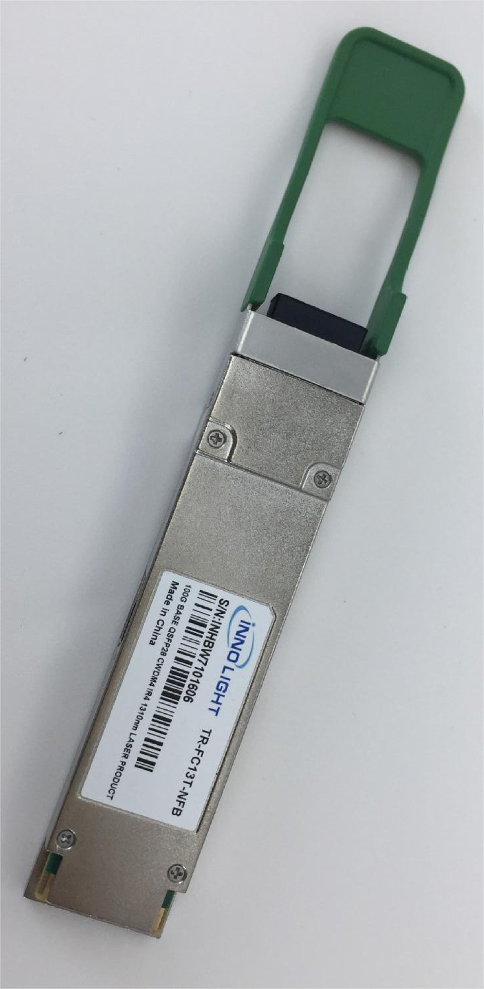
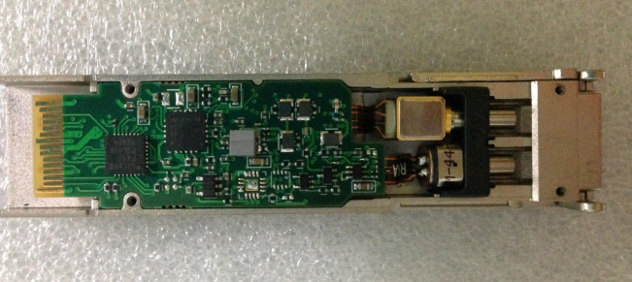
Optical Module Applications
Low-volatility thermal pad

Slide 10
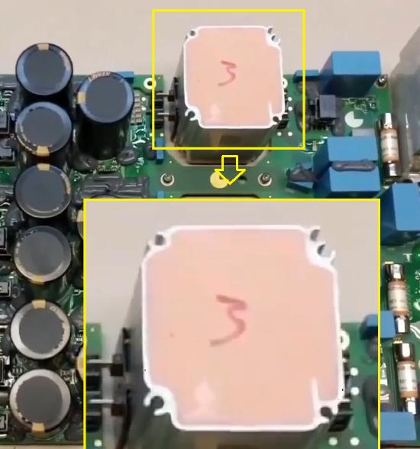
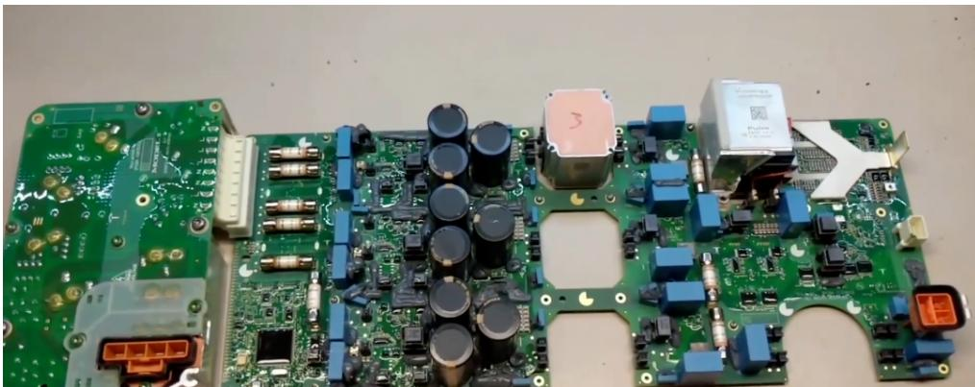
Application of PCS (Power Conversion System)
PCS stands for Power Conversion System, which is a type of energy storage inverter. It controls the charging and discharging process of the energy storage, performing AC/DC conversion. In the absence of a power grid, it can directly supply AC load. The PCS consists of a DC/AC bidirectional converter and control units. The PCS controller receives commands from the backend through communication, and based on the command signals and magnitude, it controls the converter to charge or discharge the battery, achieving regulation of active and reactive power on the grid. The PCS controller communicates with the BMS (Battery Management System) via CAN interface to obtain the status of the battery pack, enabling protective charging and discharging of the battery to ensure its safe operation.
During the charging and discharging processes, use organic thermal conductive potting compound with a power rating of 3W or higher.

Slide 11
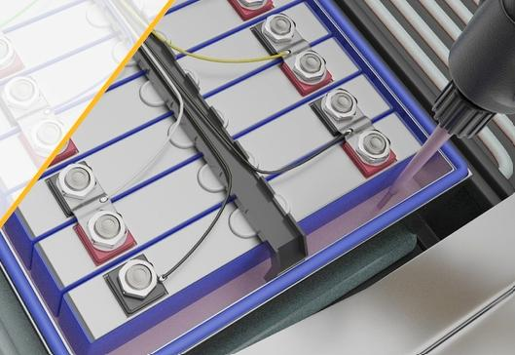
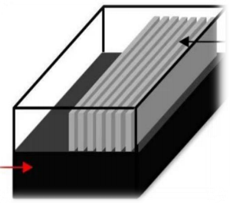
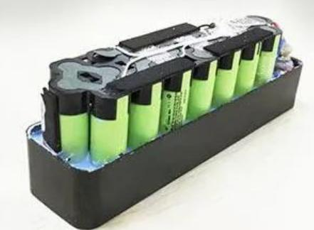
Application - Battery Pack
1. Square battery module, using organic silicone thermal conductive potting adhesive to enhance thermal management.
2. Soft pack or prismatic battery, using polyurethane thermal conductive adhesive. Polyurethane potting adhesive has good mechanical properties, providing sealing and protection for the battery cells, ensuring they are safe from impact, vibration, and shock, while also offering thermal conduction.
3. Small cylindrical battery module, using organic silicone thermal conductive potting adhesive for sealing, providing shock protection and thermal conduction.

Slide 12
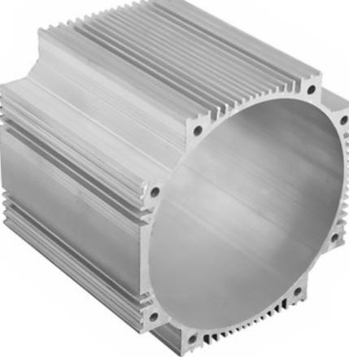
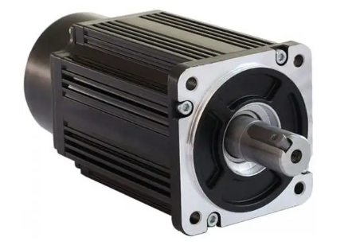
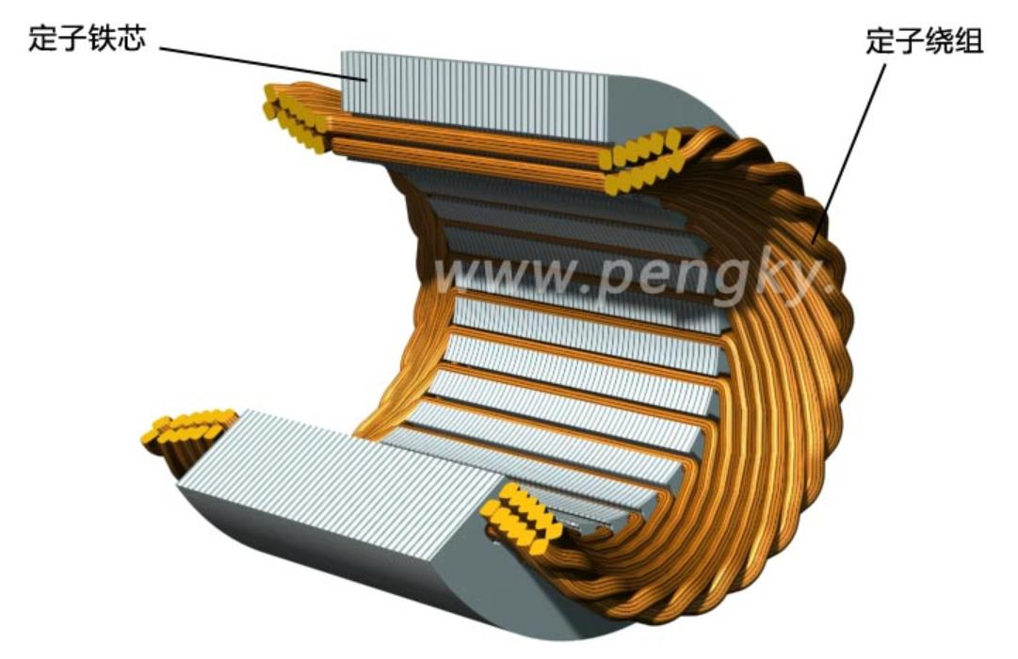
Application - Motor Potting
Epoxy thermal conductive potting material
Motor potting guide
The thermally conductive epoxy used for motor potting is applied to encapsulate the end windings, slots, and the gaps between the magnet steel sheets and the motor housing. Potting the motor stator with thermal conductive material provides good heat dissipation to the motor housing, allowing the motor to operate at a healthy temperature under normal conditions or when the power is increased.
Motor Stator Housing
Stator core and stator winding

Slide 13

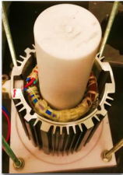
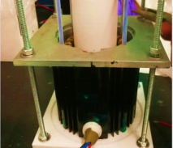
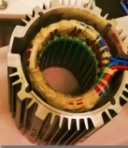
Epoxy Potting Compound Key Characteristics
- Good thermal conductivity
- High glass transition temperature of 200℃, excellent heat resistance
- 1:1 mixing ratio, easy to mix and dispense
- Low viscosity, good fluidity, facilitating construction
- Low coefficient of thermal expansion, 15 ppm/°C
- Flame retardant
PTFE
potting

Slide 14
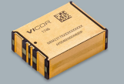
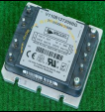
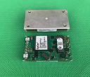
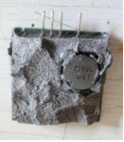
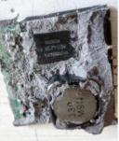
Power supply module
Internal potting with organic silicone thermal conductive potting compound. The thermal conductivity of the potting compound is determined by the power of the product, and potting compounds with a thermal conductivity of 2W/m·K and above will be used.

Slide 15
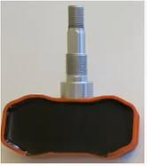
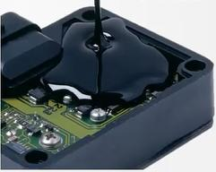
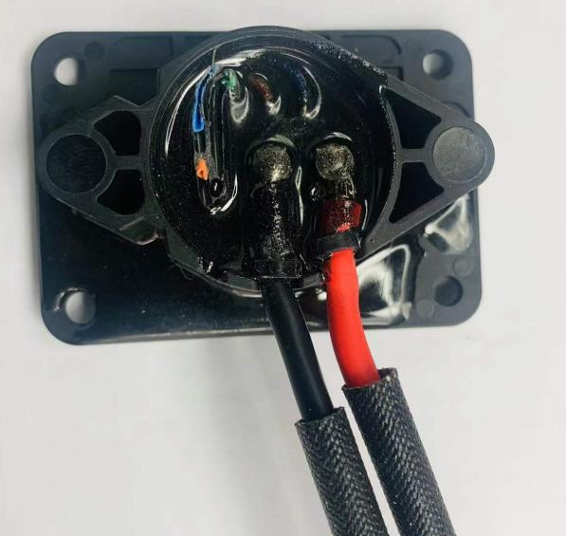
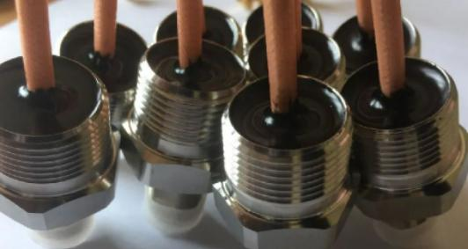
Applications - Sensors and Connectors
- Pressure Sensor - Industrial Sensor - Connector
Epoxy potting is commonly used, offering excellent adhesion to both metals and plastics, with outstanding heat resistance, environmental aging resistance, and oil resistance. It does not contain fillers.

Slide 16
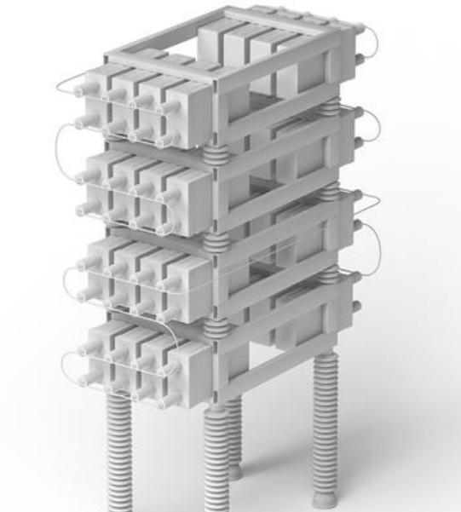
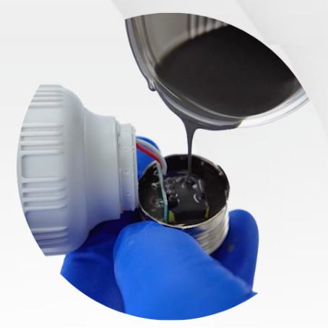
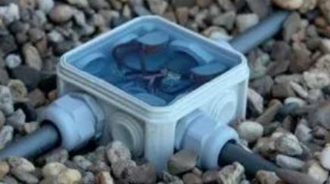
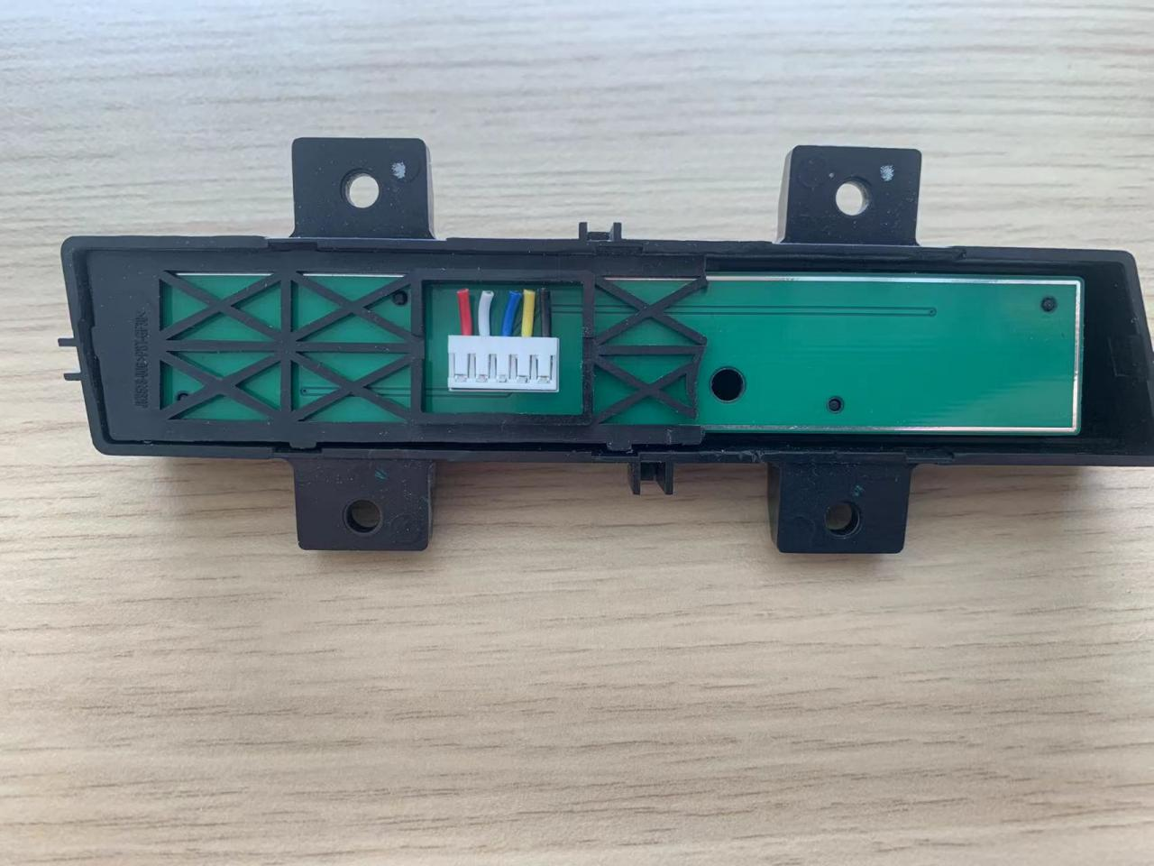
Application context
1. Energy storage capacitors, using polyurethane potting compound, provide good sealing and waterproofing.
2. LED lamp base, using potting compound for sealing, offers sealing protection, enhances performance, and extends lifespan.
3. Optical fiber cable junction box
4. Electronic anti-theft door controller

Slide 17
Summary：
Epoxy Category
Advantages
- High inherent strength
- Good oil and solvent resistance
- Good high-temperature resistance
- Low shrinkage rate
- Wide adhesion range, excellent adhesion
Disadvantages
- Most epoxies are relatively brittle and hard, with poor toughness, and cannot be reworked in most cases
- Poor resistance to thermal shock
Polyurethane Category
Advantages
Good adhesion to most substrates (non-metallic)
Excellent water resistance
Can be soft or hard
Good flexibility, high elongation at break
Good low-temperature performance
Disadvantages
Poor high-temperature resistance
Poor resistance to chemical solvents
Very sensitive to moisture during storage and use
Organic Silicone Category
Advantages
Environmentally friendly
Wide temperature range, -55~200°C
Soft, low stress
Excellent thermal shock resistance
Repairable
Disadvantages
Relatively high cost
Poor tensile strength
Low adhesion strength
Susceptible to poisoning by curing agents, such as substances containing N, P, S

